Slide 1
FINAL EVALUATION PRESENTATION SHARON C BENNY Intern – Highways Team, Jacobs Bengaluru Office

Slide 2
AGENDA
CULTURE OF CARING
TRAINING SESSIONS – CIVIL 3D & OPENROADS
PILOT PROJECT

Slide 3

CULTURE OF CARING : Celebrating Small Wins & Milestones
WHY IT MATTERS
IMPACT ON THE TEAM
Boosts team morale
Reinforces consistent effort and problem-solving
Builds positivity
Reduces stress and burnout
Encourages initiative and ownership
Strengthens collaboration and trust
WHAT TO DO
Be specific and intentional
Recognize both individuals and teams
Celebrate progress, not just outcomes

Slide 4
TRAINING SESSIONS
AUTOCAD
Overview of basic tools and layout settings
CIVIL 3D
Creating and managing Data Shortcuts
OPENROADS
Introduction to Open Roads Designer interface
Working with Points and Surfaces
Designing Horizontal and Vertical Alignments
Building Assemblies and Subassemblies
Corridor Modeling
Creating terrains, horizontal and vertical alignment and corridors

Slide 5
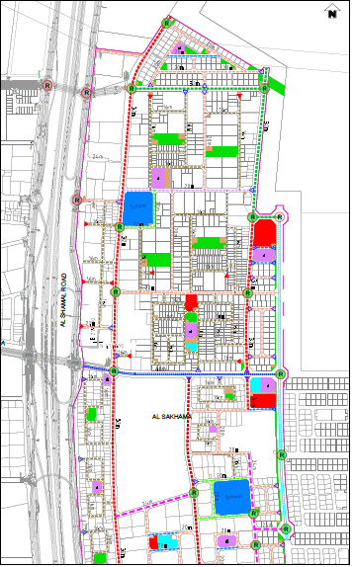
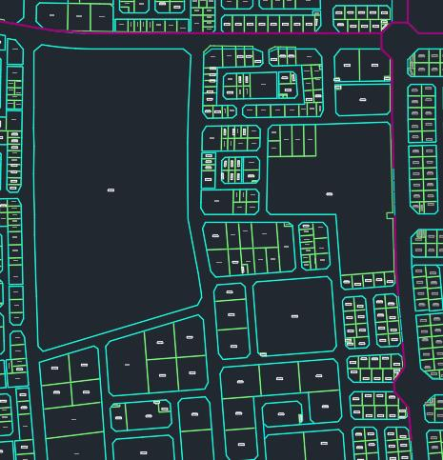
PILOT PROJECT
Project : Doha North Package 88-Design of roads and infrastructure in Al-Sakhama
Design Manual : Qatar Highway Design Manual (QHDM)
Data Provided: Existing surface, Road Network Plan & Typical Cross section

Slide 6
METHODOLOGY
Modification Of Road Network Plan
2D Layout Of Project
Designing 2D Layout For Intersections
3D Modelling of Layout & Intersections – RIRO & Roundabout

Slide 7
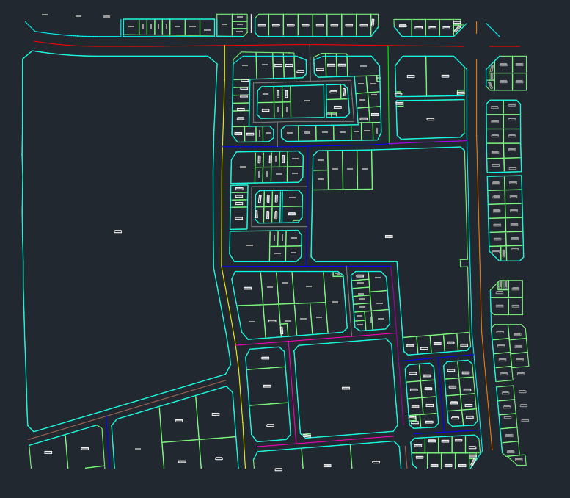
ROAD NETWORK PLAN
TCS | ROAD CLASSIFICATION | CROSS SECTION WIDTH | SPEED | COLOUR
6 | URBAN MINOR ARTERIAL ROAD | 40m | 80kmph
6 | URBAN MAJOR COLLECTOR ROAD | 40m | 80kmph
5A | URBAN MAJOR COLLECTOR ROAD | 32m | 50kmph
5C | URBAN MINOR COLLECTOR | 32m | 30kmph
4 | URBAN MINOR COLLECTOR ROAD | 24m | 30kmph
4B | URBAN MINOR COLLECTOR ROAD | 24m | 30kmph
3 | URBAN LOCAL ROAD | 20m | 30kmph
3A | URBAN LOCAL ROAD (RESIDENTIAL) | 20m | 30kmph
3B | URBAN LOCAL ROAD (SCHOOL) | 20m | 30kmph
2 | URBAN LOCAL ROAD | 16m | 30kmph
Notes:
The Road Network Plan was selected based on the RoW and the land use. And also the traffic flow.

Slide 8
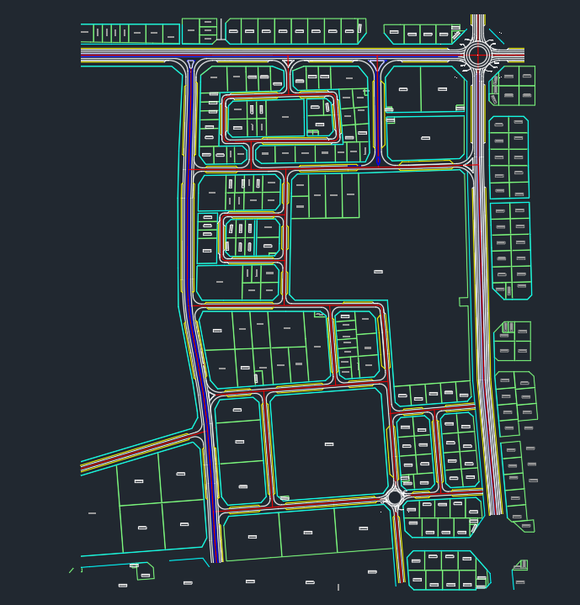
2D LAYOUT
Centerline, lane width, median
T-intersections
RIRO intersection
Roundabout

Slide 9
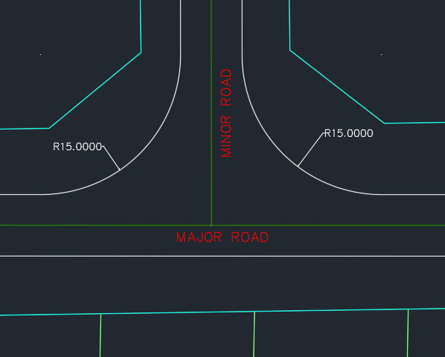
2D LAYOUT FOR INTERSECTIONS
T- INTERSECTION
QHDM – Volume 1, Part 5, Geometric Design Details for Priority Intersections
The intersection angle at a T-intersection should be between 70° and 110°.
The corner radii for Urban local and service road – 6 m.
The corner radii for other urban roads– 10 m.
Corner Radii provided -15m
Notes:
15m is taken based on the vehicle type used. Vehicle type used is based on the type of road. Based the min. turning radius of vehicles.

Slide 10
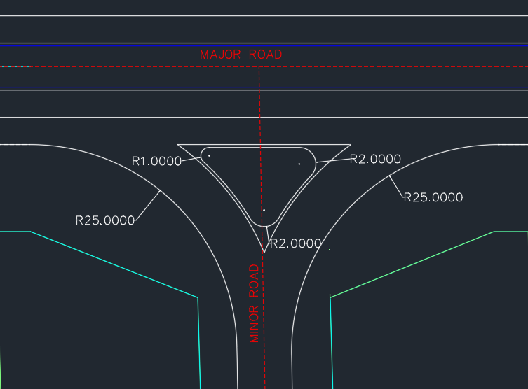
RIGHT- IN, RIGHT-OUT INTERSECTION
A Right-In Right-Out (RIRO) intersection allows only right-turn movements into and out of a side road.
QHDM - Volume 1, Part 6 : Geometric Design Details for Priority Intersections
As per Volume1, Part 6 – Table 5.2 (pg. no. 543)
Minimum corner radius (for speeds ≤ 80 km/h): 25 m
Single-lane turning roadway width (with 25 m radius): 5.7 m
Notes:
Typical layout of RIRO is given in Vol 1 Part 6 Fig 5.18

Slide 11
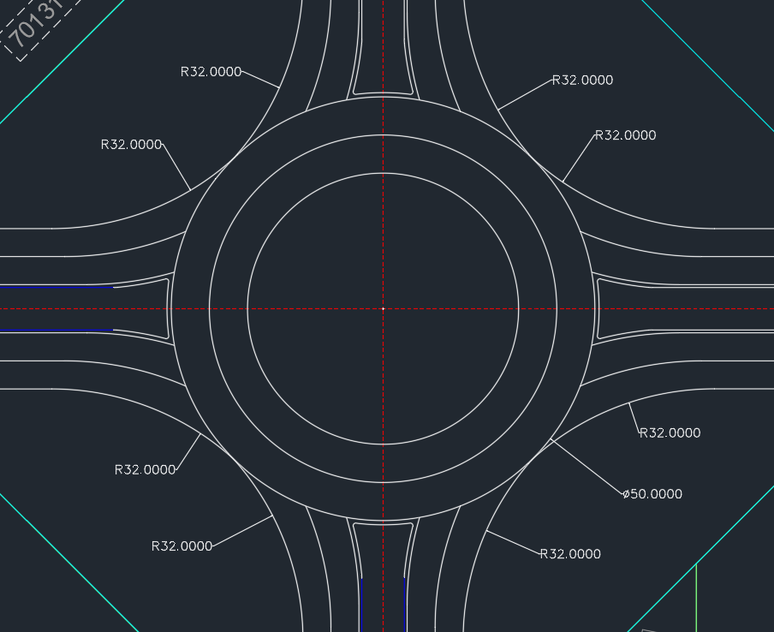
ROUNDABOUT
QHDM- Volume 1, Part 7 – Design of Roundabouts: Geometric Design

Slide 12
Geometric Parameters | QHDM |  | Design Values
 | Referred to | Standard Value | North | South | East | West
Inscribed Circle Diameter (ICD) | Volume 01, Part 07: Design For Roundabouts, Table 3.1: Minimum ICD for Roundabout | Min. 28m | 50m
Central Island Diameter | Volume 01, Part 07, Clause:3.2.3- Central island | Min. 4m | 32m
Circulating Roadway Width | Volume 01, Part 07, Clause 3.2.2 - Circulatory Roadway | 1-1.2 times the entry width | 9m
Entry Width | Volume 01, Part 07, Clause 3.2.8 -Entry Width | 7.5-9m | 8m | 8m | 8m | 8m
Exit Width | Volume 01, Part 07, Clause 3.2.12 - Exit Width | Greater than or equal to entry width | 8m | 8m | 8m | 8m
Entry Curb Radius | Volume 01, Part 07, Table 3.3 -Entry Curb Radius | Min. 20m | 32m | 32m | 32m | 32m
Exit Curb Radius | Volume 01, Part 07, Table 3.4-Exit Curb Radius | Max. 100m | 32m | 32m | 32m | 32m

Slide 13
DESIGN CHECK
Parameter | Referred to | Standard Values | Design Values
 |  |  | North | South | East | West
Average effective flare length | Volume 01, Part 07, Clause 3.2.9 -Average Effective Flare Length | Min. 5m | 5.2m | 5.2m | 5.2m | 5.3m
Entry angle | Volume 01, Part 07, Clause 3.2.10 – Entry angle | Between 20º - 60º | 31º | 31º | 31º | 31º
Entry path radius | Volume 01, Part 07, Clause 3.2.11 – Entry path radius | Max. 100m | 98m | 98m | 99m | 99m

Slide 14

SWEPT PATH ANALYSIS
Swept Path simulates vehicle movement through intersections, roundabouts, and roadway layouts based on vehicle dimensions and steering behavior.
Validates safe and conflict-free turning paths to ensure vehicles navigate the design without encroaching on curbs or adjacent lanes.

Slide 15
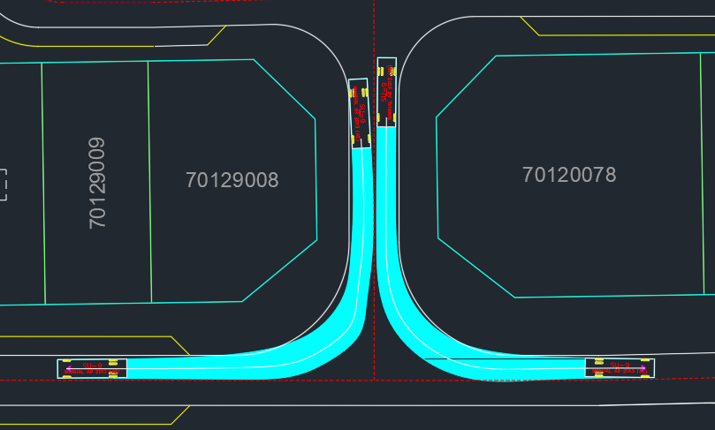
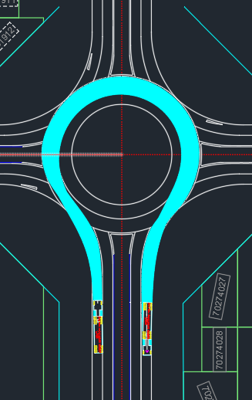
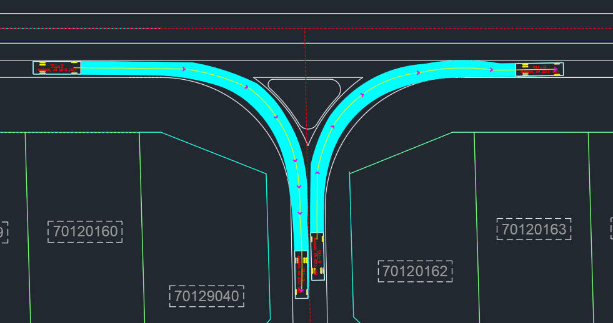

Slide 16
3D MODELLING
HORIZONTAL ALIGNMENT
VERTICAL ALIGNMENT
ASSEMBLIES & SUB-ASSEMBLIES
CORRIDOR MODELLING
EXISTING SURFACE

Slide 17
EXISTING SURFACE
A Surface is a 3D representation of ground or terrain.
TIN (Triangulated Irregular Network) is the most common type of surface, made by connecting points with triangles.
Surfaces are important because they are used in terrain modeling, alignment design, and volume calculations
Surfaces can be created from survey points, point files, point groups, or imported using formats like LandXML or DEM.

Slide 18
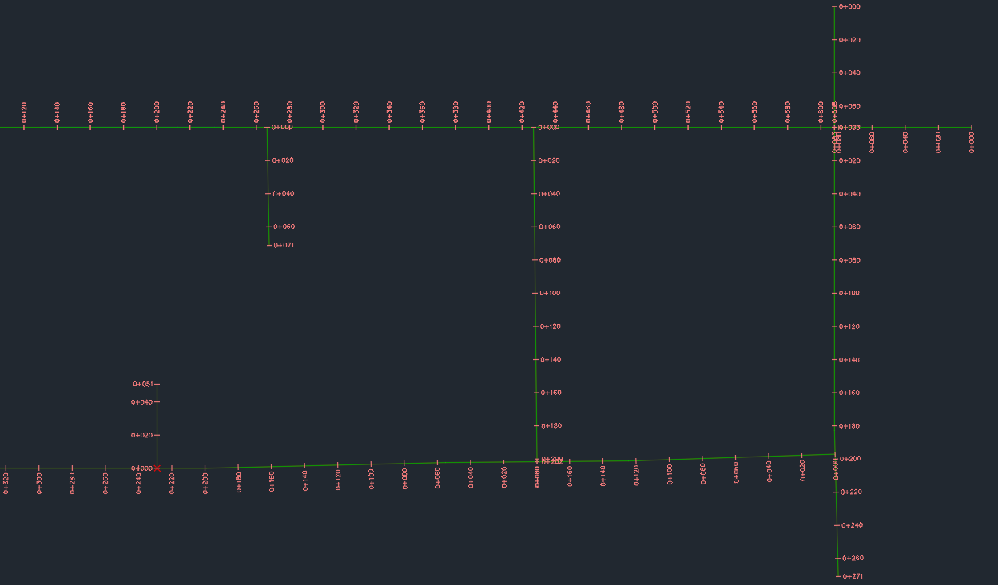
HORIZONTAL ALIGNMENT
A sequence of straight segments connected by curves and transitions.
Methods of Alignment Creation:
Alignment Creation Tools -Manual method using IP (Intersection Point) or Element-based design.
Alignment from Objects-Converts a 2D polyline into a design alignment.
Best Fit Alignment- Creates alignment by fitting through selected points or objects.
Offset Alignment- Creates a parallel alignment at a specified offset distance from the centerline.

Slide 19
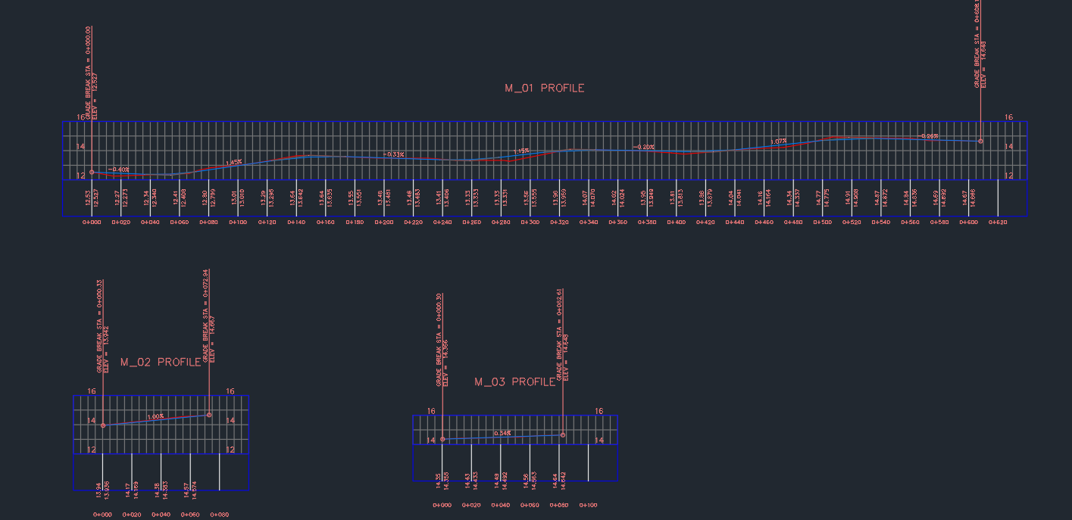
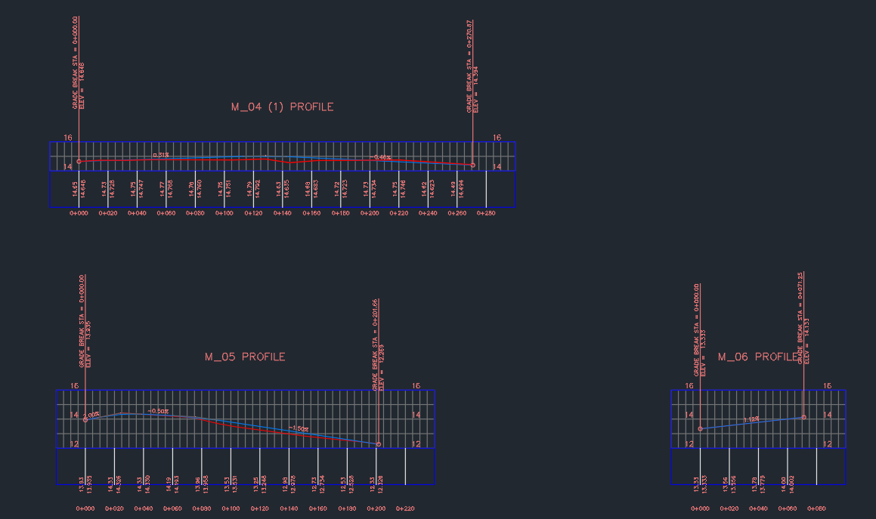
VERTICAL ALIGNMENT
A profile represents the vertical alignment of a road or highway along a defined horizontal alignment.
It consists of longitudinal grades and vertical curves.
Types of Profiles:
Existing Ground Profile – Extracted from a surface to show natural terrain.
Proposed Profile – Designed using valleys and summit curves to achieve smooth vertical transitions.
Profile → Create Surface Profile

Slide 20
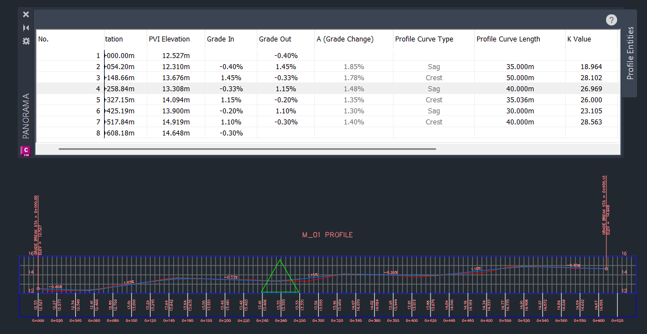
As per QHDM (Vol 1, Part 3: Roadway design elements)
Longitudinal grades: Min - 0.3% and Max - 4% ( Clause 4.2-Longitudinal Grades)
Minimum K value for Vertical curves (for 80kmph) – 26 (crest), 17 ( Sag) ; Clause 4.3 Vertical curves- Table 4.2 & Table 4.3)

Slide 21
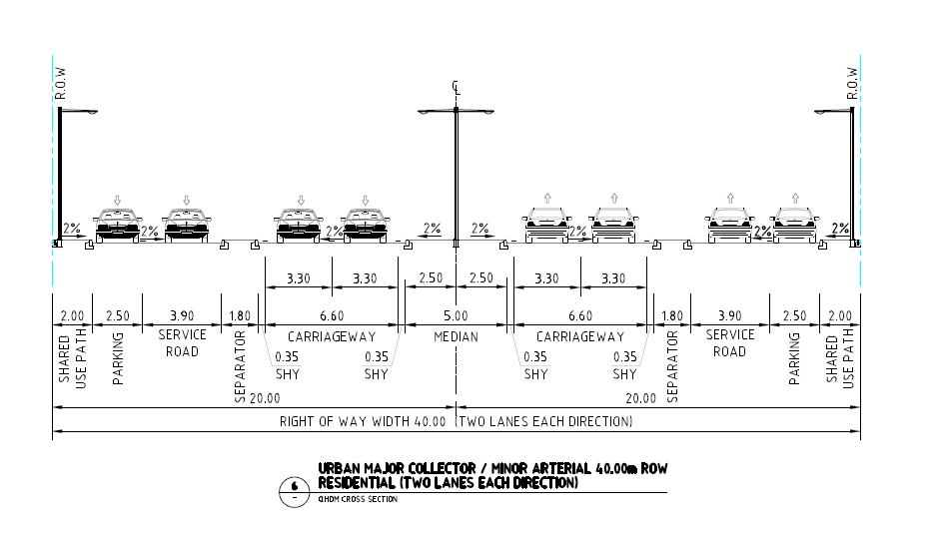
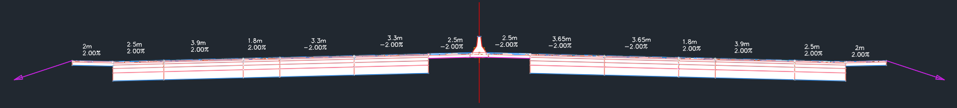
ASSEMBLIES & SUB-ASSEMBLIES
The subassemblies defines individual roadway components like lanes, shoulders, curbs, and ditches.
They are made up of points, links, and shapes.
Assemblies are formed by arranging multiple subassemblies relative to a centerline (baseline).
Used to create cross-sectional templates for corridor modeling.
Home tab → Create Assembly and select a typical assembly type.
Subassemblies are inserted from the Tool Palettes.

Slide 22
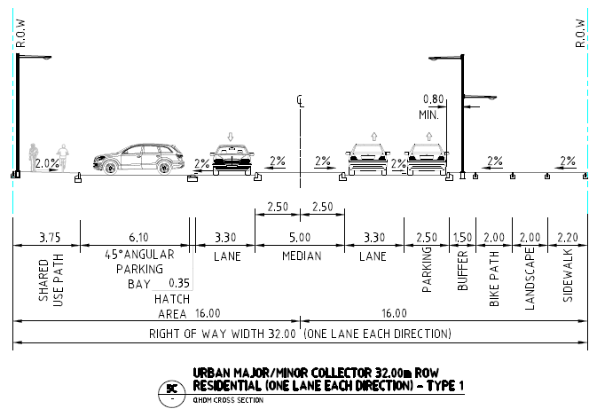
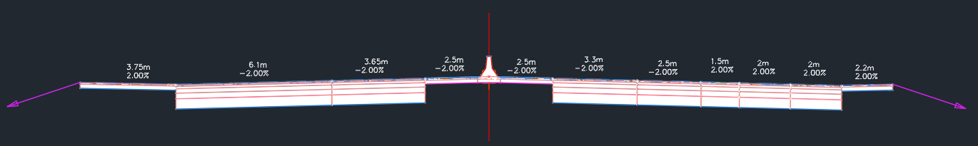
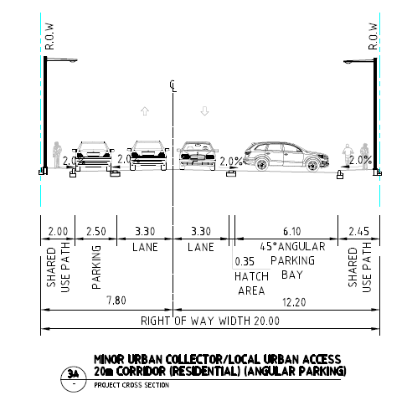
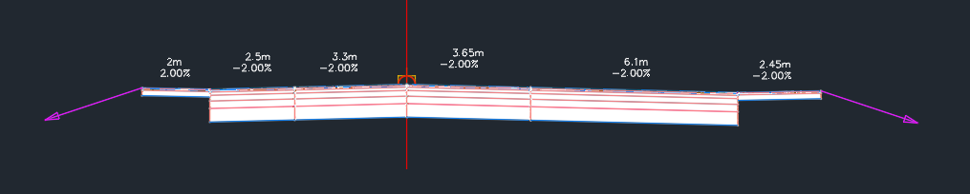

Slide 23
CORRIDOR MODELLING
A corridor is a 3D model generated by applying assemblies along a horizontal alignment and vertical profile.
Key Components of a Corridor
Alignment - Defines the horizontal path of the corridor.
Profile - Defines the vertical geometry (elevation) along the alignment.
Assembly - Cross-sectional template composed of subassemblies applied at each station.
Target Mapping - Assigns dynamic links to surfaces, polylines, or feature lines.
Regions and Baselines
Baselines refer to alternate alignments/profiles within the same corridor.
Divide the corridor into sections (regions) where different assemblies can be applied.

Slide 24
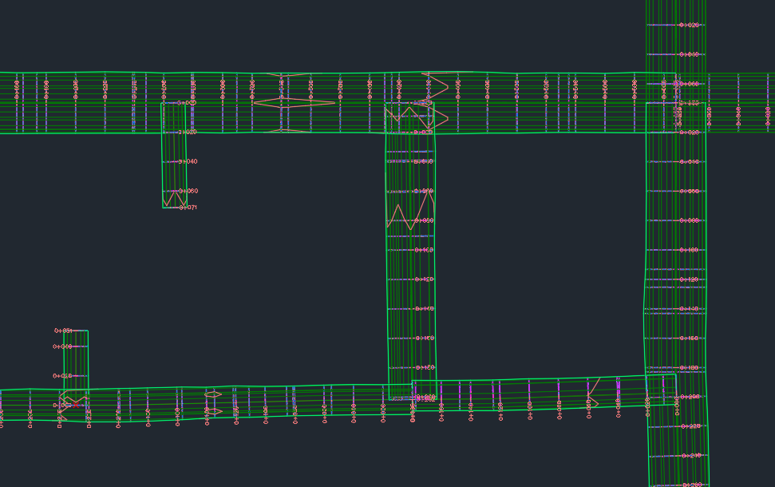
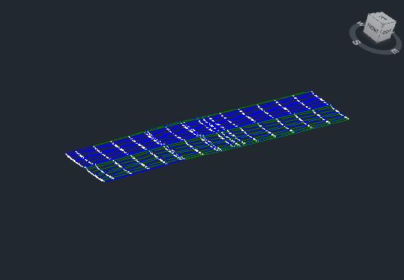

Slide 25
3D MODEL OF INTERSECTIONS
2D Junction Layout
Import Existing Surface
Convert centerlines to Alignments -Use the "Alignment from Object" tool to define major and minor road alignments.
Tie Alignments to Avoid Grade Differences Merge alignment profiles to ensure smooth elevation transitions.
Generate Vertical Profiles
Create Assembly with Subassemblies
Build Major and Minor Corridors Assign assemblies to alignments and generate corridors.
Design Junction Alignments Radii-based alignments were designed using "Alignment from Object" tool to model junction connections.
Create Junction Profiles Define vertical geometry for each junction alignment.
Develop Junction Corridors Use junction alignments and profiles to create smooth corner grading.
Target Intersection Corridor
Apply target mapping to ensure corridor components respond to adjoining geometry.
Add Corridor Surfaces and Apply Contour Style
Build corridor surfaces and apply contour styles for grading visualization.

Slide 26
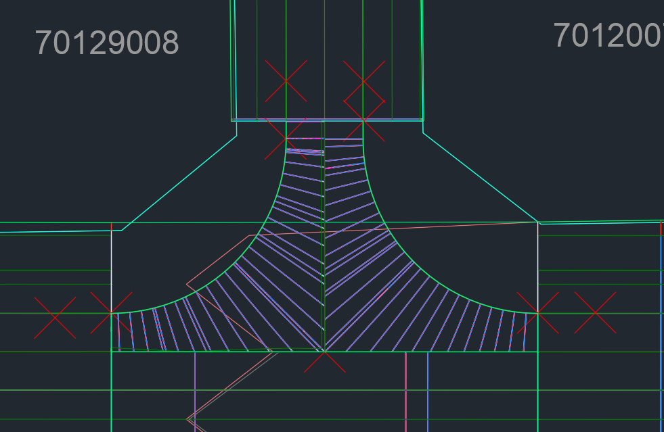
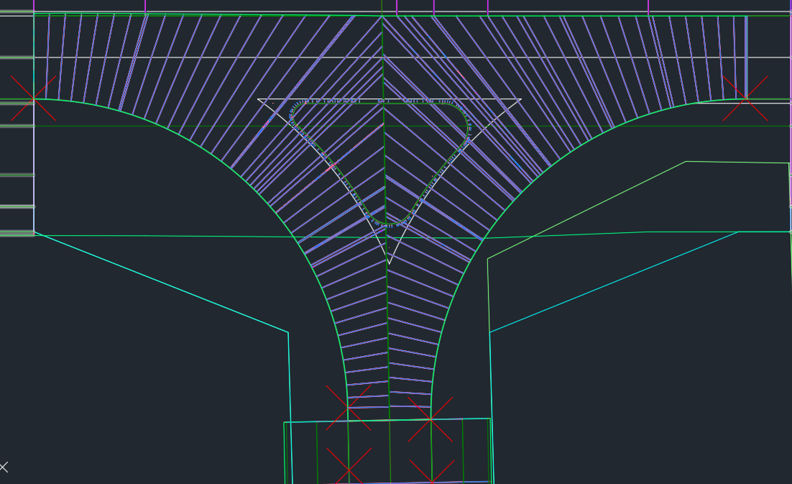
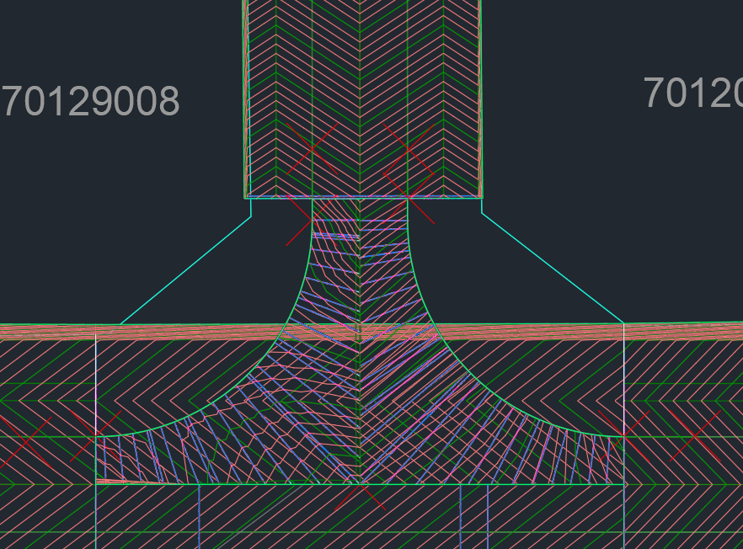
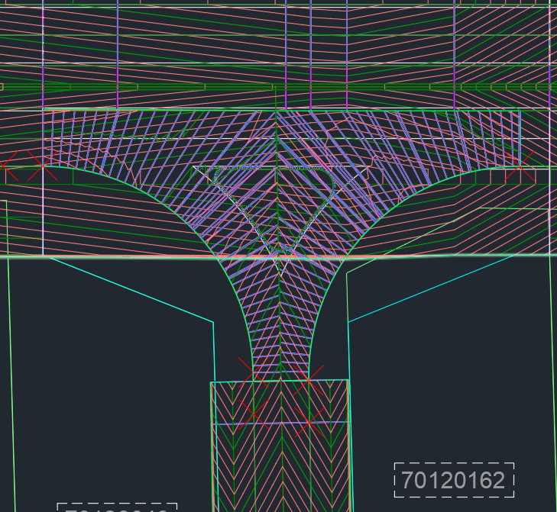
T- INTERSECTION
RIRO

Slide 27
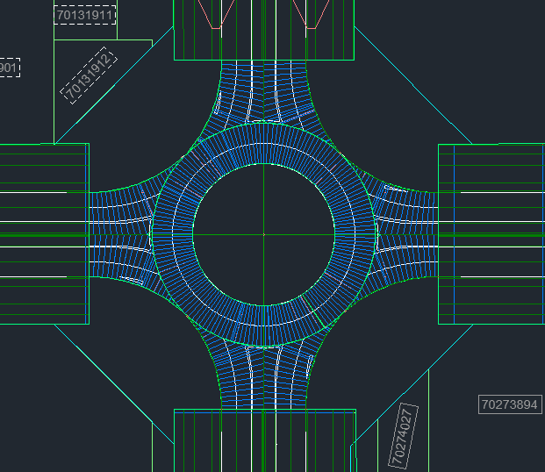
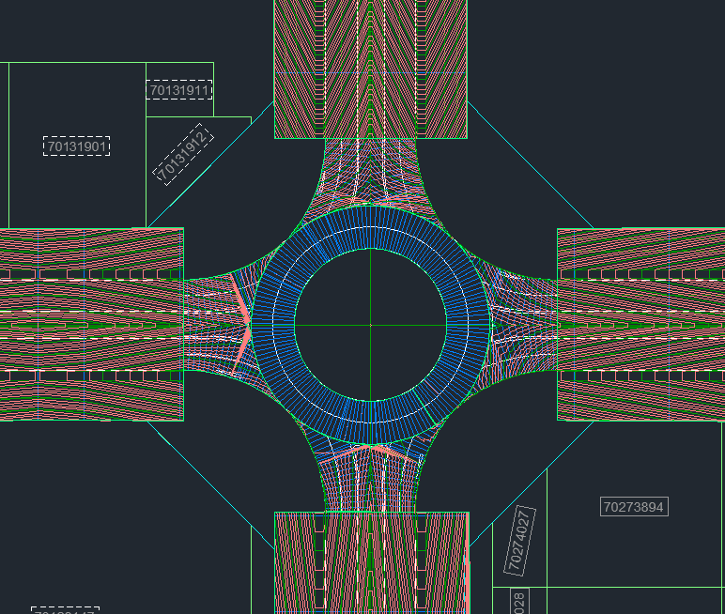
3D MODEL OF ROUNDABOUT

Slide 28
KEY TAKEAWAYS
Strengthened technical knowledge and design understanding
Gained software proficiency
Exposure to real-world projects and practical applications
Familiarity with codes and standards
Insight into corporate work culture
Enhanced communication
Developed confidence

Slide 29

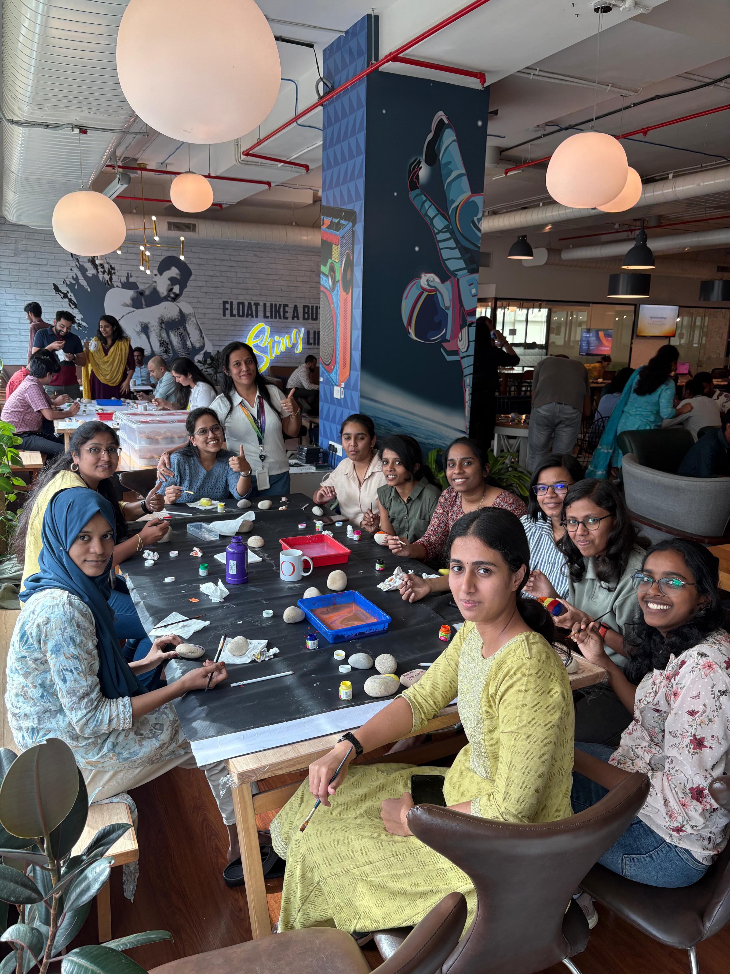


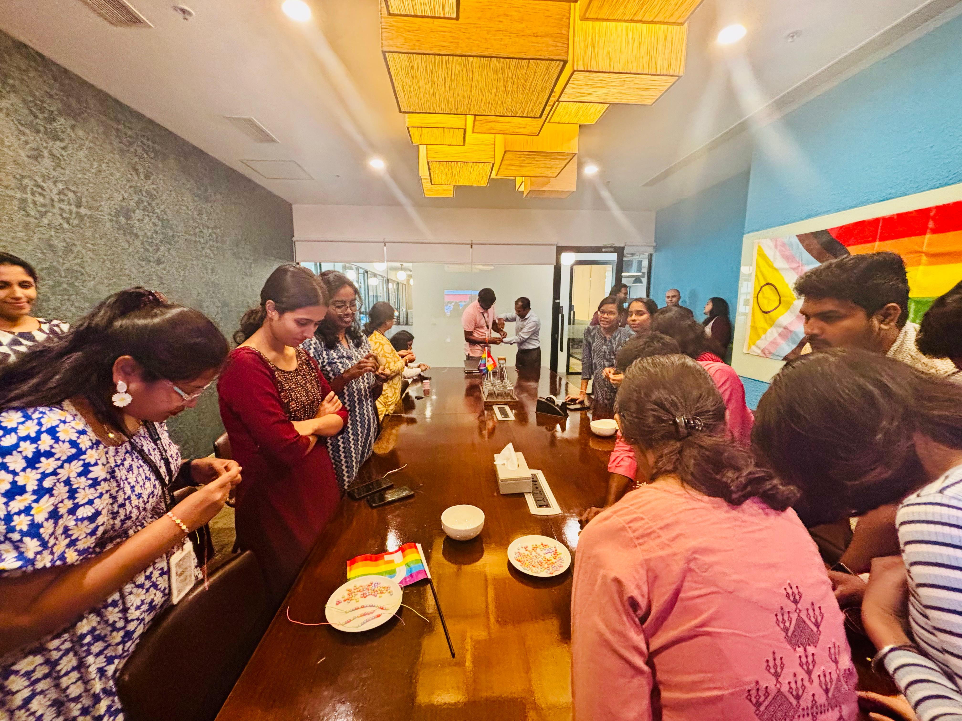
LIFE AT JACOBS

Slide 30
ACKNOWLEDGEMENT
Murugappan Mahalingam ( Engineering Manager – Highways)
Manjunath Ramakrishna (Senior Lead Engineer – Highways)
Prashanth Kavu ( Team Lead )
K Surabhi ( Senior Engineer – Highways)
Sushmitha Shivappa ( Engineer – Highways)
Prashanth Manam ( Deputy Engineer – Highways)
Aditi Gandhi ( Engineer – Highways)
Ayana H ( Engineer – Highways)
Buvana S (Senior Engineer – Highways)
Praveen Mugalkhod (Lead Engineer – Highways)
Kezia Shiji( Engineer – Highways)
Vasu G S (Deputy Engineer – Highways)
Sahana Upadhye (Apprentice Graduate Engineer – Highways)

Slide 31
THANK YOU

